Slide 1


Slide 2

Human Resource Manager
Name : Sheela

Slide 3
TYPES OF WORKERS NEEDED
● BLUE COLLAR JOBS
1. Sweepers
2. Warehouse employees
3. Security guards
WHITE COLLAR JOBS
1. Chief executive officer
2.Department managers
3.Senior Engineers
4.Company secretary

Slide 4
SOURCES OF RECRUITMENT
Blue collar jobs :
Recruitment at factory gate
White collar jobs:
1. News paper add
2. Placement agencies
3. Website ( Naukri. Com )

Slide 5
QUALIFICATION
Engineers : B E in Electronics & Communications
Company secretary : B com & LLB
Blue collar workers : 10th pass

Slide 6

Selection process
Fill application form
Test
Interview
Reference check
Job offer

Slide 7
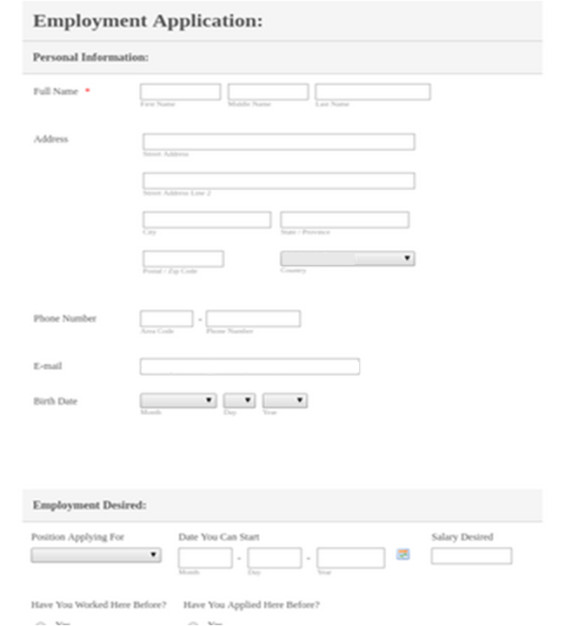
Fill Application Form
Helps to shortlist candidates for test and interview based on the information provided by them

Slide 8


TEST
Aptitude tests will test employee’s ability to perform tasks and react to situations at work. This includes problem-solving, prioritization and numerical skills, amongst other things.
Interest tests will test employee’s interest in the job. This is taken to reduce labour turnover

Slide 9

Personality tests measures the future performance of an employee. Their leadership qualities is also known

Slide 10

INTERVIEW
Stress interview is conducted for both Engineers and company secretary
Reasons:
Engineers have to manage interns CS is not that tough like other jobs where you feel stressed and gets problems related to health and dissatisfaction from the job

Slide 11
Employee Benefits:
Number of leaves available per year
Casual leaves ( C L ) 7 days
Sick leave with payment – 10 days (100 per month)
Maternity Leaves:
26 weeks , ( Maternity benefit Amendment Act 2017 )

Slide 12
Number of directors | Sitting fees per meeting (In Rs.)
1 Managing Director | 3,000
1 Executive Director | 3,000
1 Non Executive Director | 3,000
There are four meetings in a year. There will not be more than 120 days gap between 2 consecutive meeting.

Slide 13
Employee salary:
Designation | Basic | Bonus | HRA | Special Allowance | Convey. Allowance | Gross | PF | ESI | Prof Tax | Net Salary
CEO | 29,400 |  | 4,000 | 5,000 | 1,600 | 40,000 | 3528 | - | 200 | 36,272
Managers(All) | 22,200 |  | 3,200 | 5,000 | 1,600 | 32,000 | 2664 | - | 200 | 29,136
Company Secretary | 18,200 |  | 2,200 | - | 1,600 | 22,000 | 2184 | - | 200 | 19,616
Engineers | 20,400 |  | 3,000 | 5,000 | 1,600 | 30,000 | 2448 | - | 200 | 27,352
Warehouse workers | 3,770 | 630 | 1,000 | - | 1,600 | 7,000 | 452.4 | 122.5 | - | 6,425.1
Sweepers | 2,860 | 540 | 1,000 | - | 1,600 | 6,000 | 343.2 | 50.05 | - | 5,606.75
Designation
Basic
Bonus
HRA
Sp.convience
Convince
Gross
PF
ESI
P Tax
NetDesignation
Basic
Bonus
HRA
Sp.convience
Convince
Gross
PF
ESI
P Tax
Net
CEO
29400
-
4000
5000
1600
40000
3528
-
200
36272
Managers (All)
22200
-
3200
CEO
29400
-
4000
5000
1600
40000
3528
-
200
36272
Managers (All)
22200
-
3200

Slide 14
The Security Guard Jobs was outsourced to All protect Pvt.Ltd. And payment of Rs.8,000 was made every month 8 Interns were hired on yearly basis from Engineering Colleges and Rs.1,500 was paid monthly

Slide 15
Calculation of Cost to company
Designation | Net | Employer’s ESI Contribution | Employee’s ESI Contribution | Employer’s Pf Contribution | Employee’s Pf Contribution | Prof Tax | CTC
CEO | 36,272 | - | - | 3,822 | 3,528 | 200 | 43,822
Managers(All) | 29,136 | - | - | 2,866 | 2,664 | 200 | 34,866
Company Secretary | 19,616 | - | - | 2,366 | 2,184 | 200 | 24,366
Engineers | 27,352 | - | - | 2,652 | 2,448 | 200 | 32,652
Warehouse workers | 6,425.1 | 332.5 | 122.5 | 490.1 | 452.4 | - | 7,822.6
Sweepers | 5,606.75 | 285 | 50.04 | 371.8 | 343.2 | - | 6,656.79

Slide 16
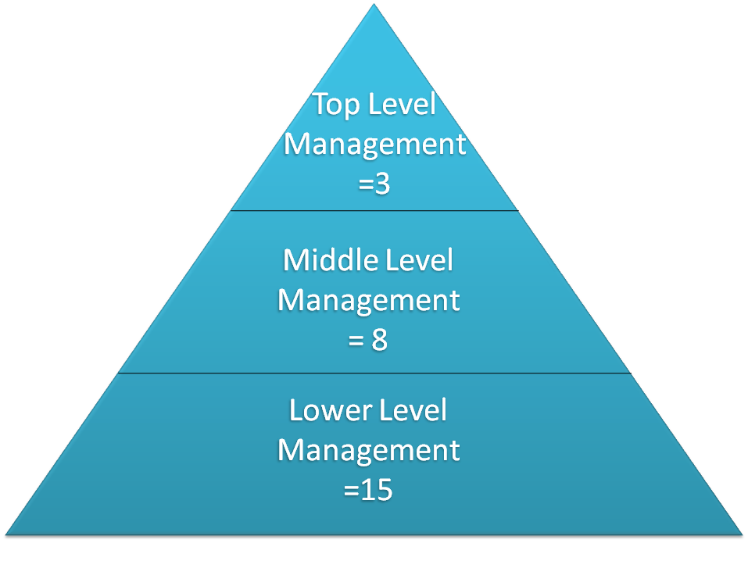

Slide 17
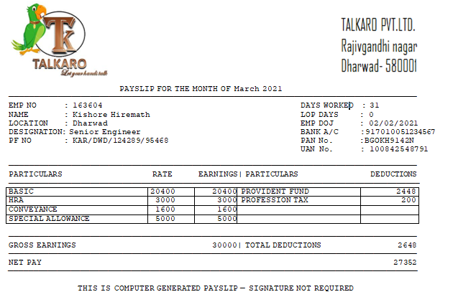
Pay slip:

